Slide 1
COMP1021 Introduction to Computer Science
Turtle Graphics

Slide 2
Learning Outcomes
Outcome 1: Initialize the environment of Python successfully under the course instructor’s guidance
Outcome 2: Use Turtle in Python to draw graphics correctly without others’ assistance

Slide 3
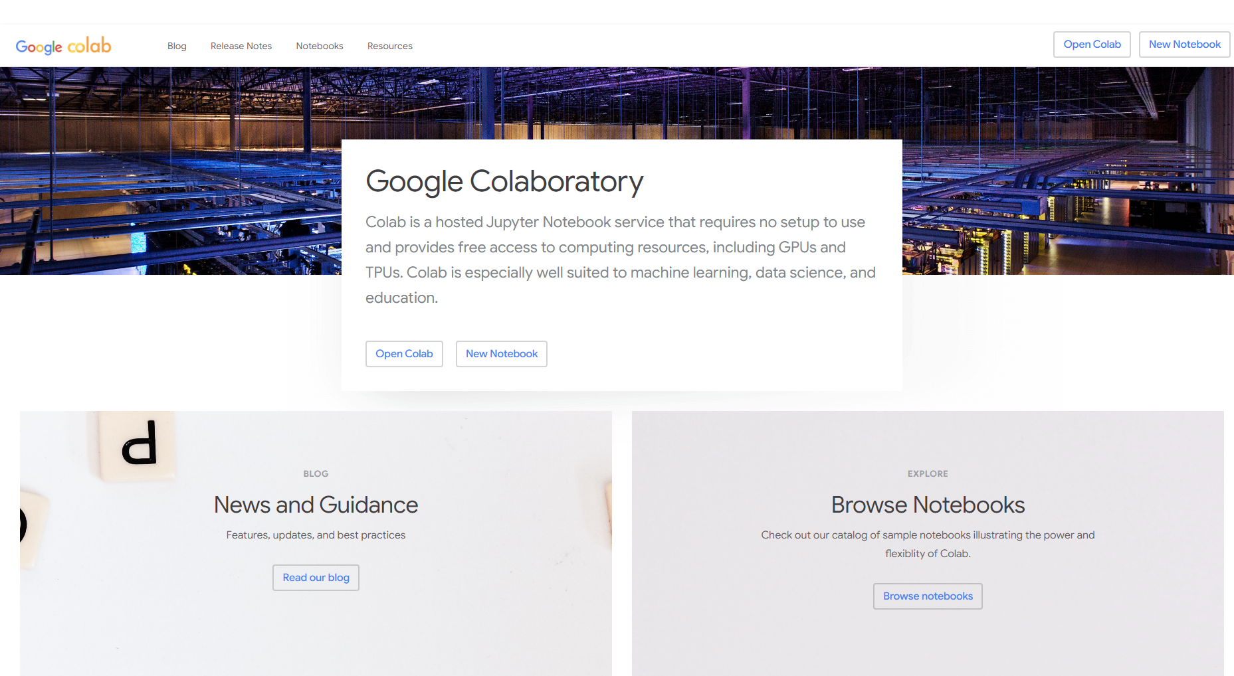
Unlock the Power of Google Colab
Google Colab is a free, cloud-based platform that provides a complete Python environment for machine learning and data analysis projects. This guide will show you how to get started.

Slide 4
Step 1: Creat Your Account
1
Open Google Colab
2
Access with Email
3
Complete Registration
Open the Google Colab website (https://colab.research.google.com/).
Google Colab is fully integrated with Gmail, so you can easily sign in and start using it immediately.
Once you're signed in, follow the simple steps to complete your registration and start using Google Colab.

Slide 5
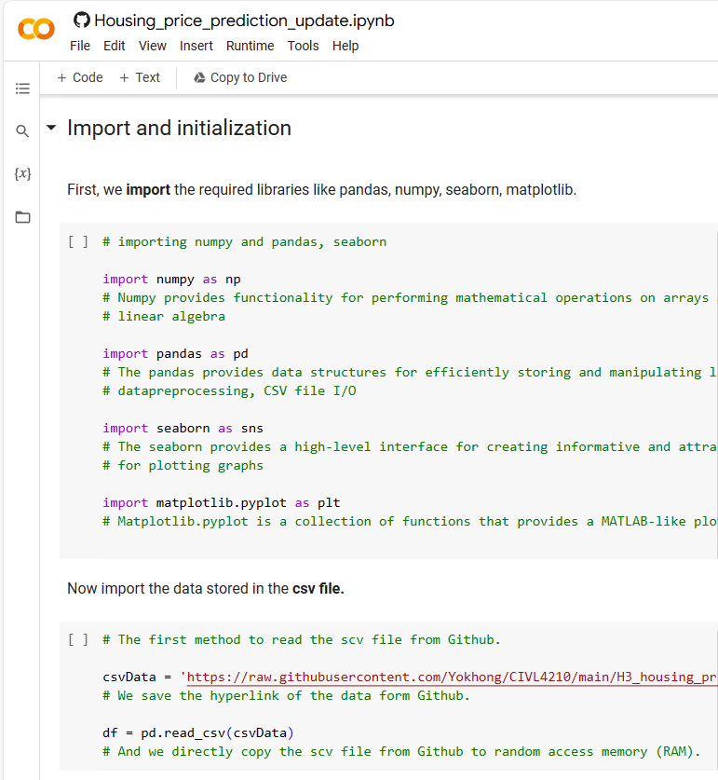
Step 2: Understand the Colab Interface
Menu bar:
It contains various options for managing and running your notebook, such as saving, running code cells, and changing runtime settings.
Text cell:
You can add text explanations or notices using text cells. They are useful for providing instructions or adding comments to your code
Code cell:
This is where you can write and run Python code. Each code cell can be run individually.

Slide 6
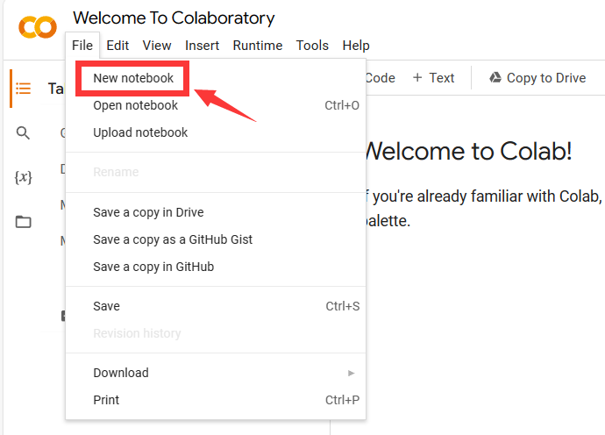
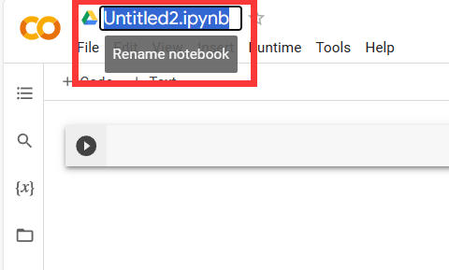
Step 3: Creat a New Notebook
Step 3.1: Click on "New Notebook"
Step 3.2: Give your notebook a name
In the dashboard, click the “file” button and then the “New Notebook” button to create a new Colab notebook.
A dialog box will appear and ask you to provide a name for your notebook. Enter a descriptive name that reflects the purpose of your project.

Slide 7
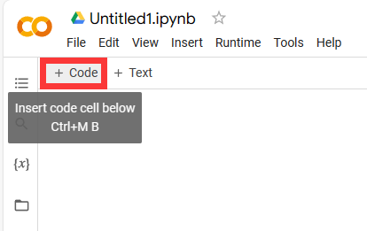
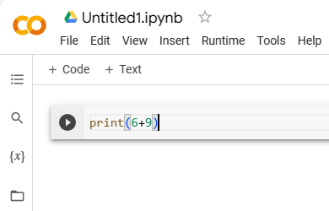
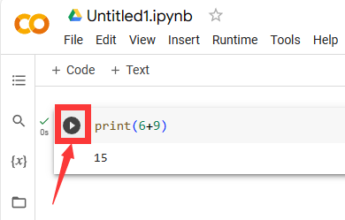
Step 4: Write and Run the Code
Step 4.1：Adding a code cell
Step 4.2：Writing your code
Step 4.3：Run the code cell
To add a code cell, simply click on the "+" button in the toolbar.
In the code cell, you can write your Python code. For example, we add 6+9, and we print the result.
print(6+9)
you can click the play button.

Slide 8
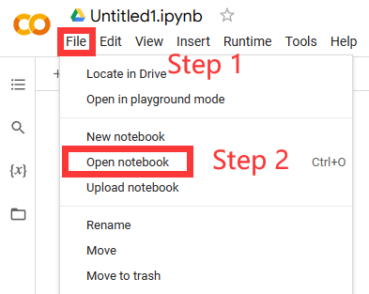
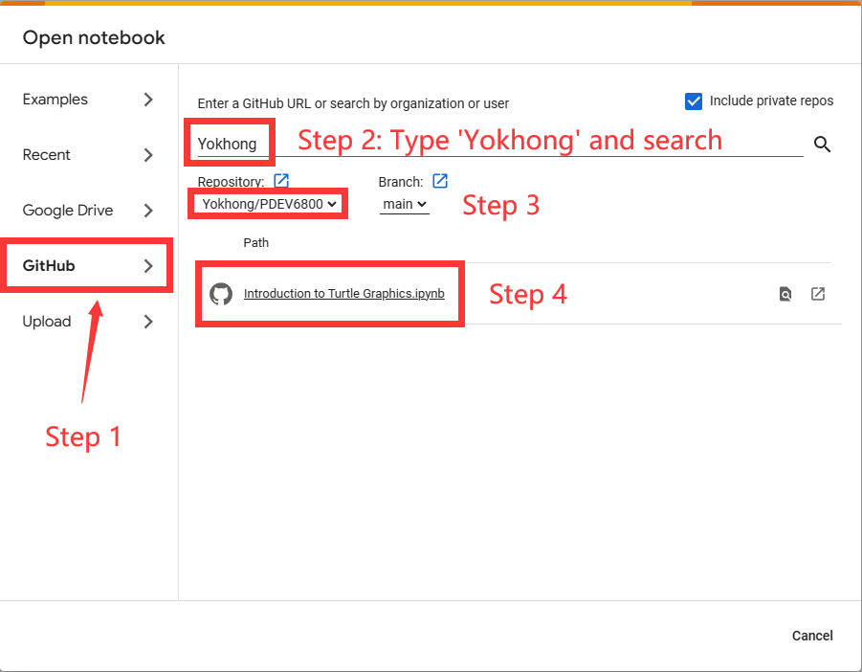
Step 5: Open an Existing Notebook
Start from Scratch
Open Existing Notebook
Import form Github
Access the Notebook menu to create a new, blank notebook in Google Colab.
If you already have a notebook, you can easily open it in Google Colab by selecting it from your files.
Google Colab makes it easy to import existing notebooks from websites like Github.

Slide 9
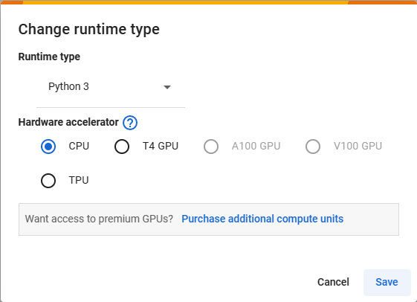
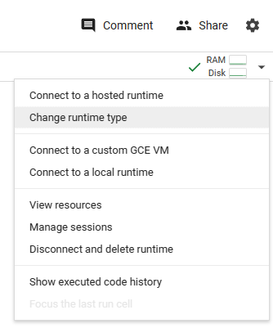
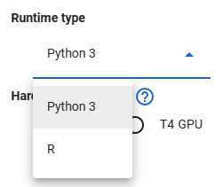
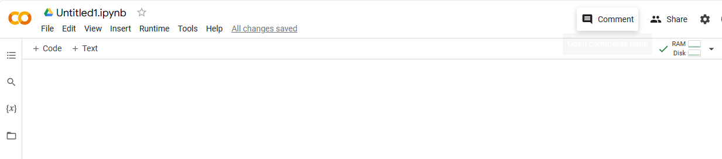
Step 6: Change the Runtime Type

